Slide 1
KP6 Agent Feedback
Mercy Langat
Charlton Omondi

Slide 2
Approach
KOKOpoint agent feedback project was undertaken to collect input from a representative group of KOKO Agents regarding their experience with the deployment and operation of v6 and 6.1 KOKO Points in their shops.
This exercise ran from 16th Nov to 27th Nov 2020 and was undertaken as below:
ACTIVITIES
Profiled the different types of Agents to target for feedback
Prepared shortlist of names based on input from Agent team
Drafted “KP6 Feedback Discussion Guide” & review across teams to ensure key topics are covered
Arranged phone call / visits with Agents
Used “KP6 Feedback Discussion Guide” to structure the session for collecting feedback
Synthesized findings and any recommendations for deep dive areas & prepare final deliverable
WORK PRODUCTS
Agent profiles & shortlist for feedback collection
KP6 Feedback Discussion Guide
Agent call/visit list tracker
Discussion notes
Final deliverable presentation

Slide 3
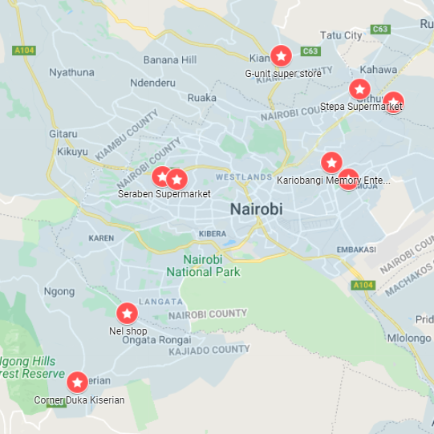
Representative KOKO Agents
 | Profile name | Description | KOKO Agents
8 | Innovative / engaged | Regularly comes up with ideas, highly engaged with KOKO, participates in experiments | Stepa Supermarket
7 | Big shop | Large shop area & footfall, prominent location | Fair Price Cereals Shop
9 | Best seller | High level of Cooker and fuel sales | G-unit super store
6 | Regular shop | Medium shop area & footfall, off-the-track location | Kariobangi Memory Enterprise
5 | Worst seller | Low level of Cooker and fuel sales | GENESSIS ATM MILK
7 | Multiple KPs in Shop | One of the recent shops to get second KP | Fair Price Shop Githurai
4 | Old-timer | Been with KOKO from early days / v5 | Seraben Supermarket
3 | Internal refill box? |  | Frawaki Supermarket
1 | Distance from where we park tankers | Agent’s farther away often suffer stockouts | Corner Duka Kiserian
2 | Tiny shop | Extremely small shop/kiosk/counter | Nel shop
9
8
7
6
4
3
5
2
1
Map 1: Participating KOKO Agents

Slide 4
Feedback Areas
Discussion Guide
How was KP installation experience at your shop (information, civils, delivery, set up, commissioning)? Improvement ideas?
How well does KP fit and look in your shop? Anything you wish we had added or changed? (appearance, size, etc.)
How well does the KP work ? (i.e. dispense fuel safely to customers without taking your time).
What step in using KP do KOKO Customers need your help with the most?
(if 1 KP in shop: ) Do you feel the KP gets too busy sometimes in the evening (long wait)? How should we address that?
(if 2 KPs in shop:) Is 2 KPs a good way to ensure you have enough fuel for customers? Why? Or 1 KP with bigger tank?
Do customers leave their empty Canisters in your shop ? Why? How could we better meet their needs?
Anything more the KP should do to benefit you or CUstomers?
How do you feel about what shows on the KP screen and the audio level of the KP?
What do you think of the refilling system? Anything about this that needs to be improved?
Any suggestions regarding how the KOKOpoint is maintained/fixed by KOKO?
What do you feel about Safety of the KP? Has your view changed over time? Any way things could be safer?
Any other comments, concerns, ideas for KOKO? (cooker storage? cooker repair? helping customers top up? )
Feedback structures as below;
Installation & Commissioning
Size/Shape & Aesthetic Appeal
Fuel Refilling (KP and Customer Can Refills)
Fuel Storage & Inventory Monitoring
Fuel Dispensing
Fuel Quality
Unit Internal Access & Maintenance
Fuel Safety Features & Hazard Avoidance
Power Supply & Backup
Screen User & Interface
Connectivity & Remote Monitoring
Security and Self Protection
General KP use Feedback

Slide 5
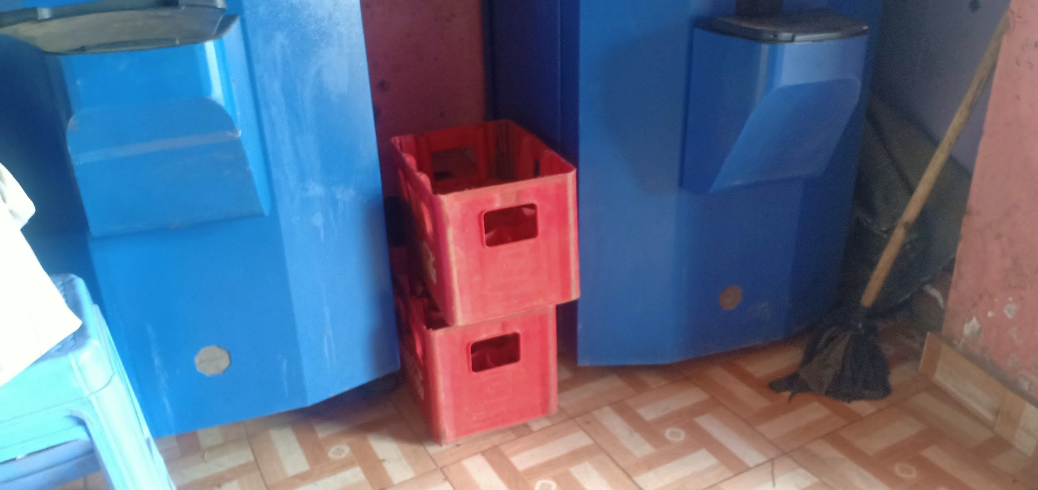
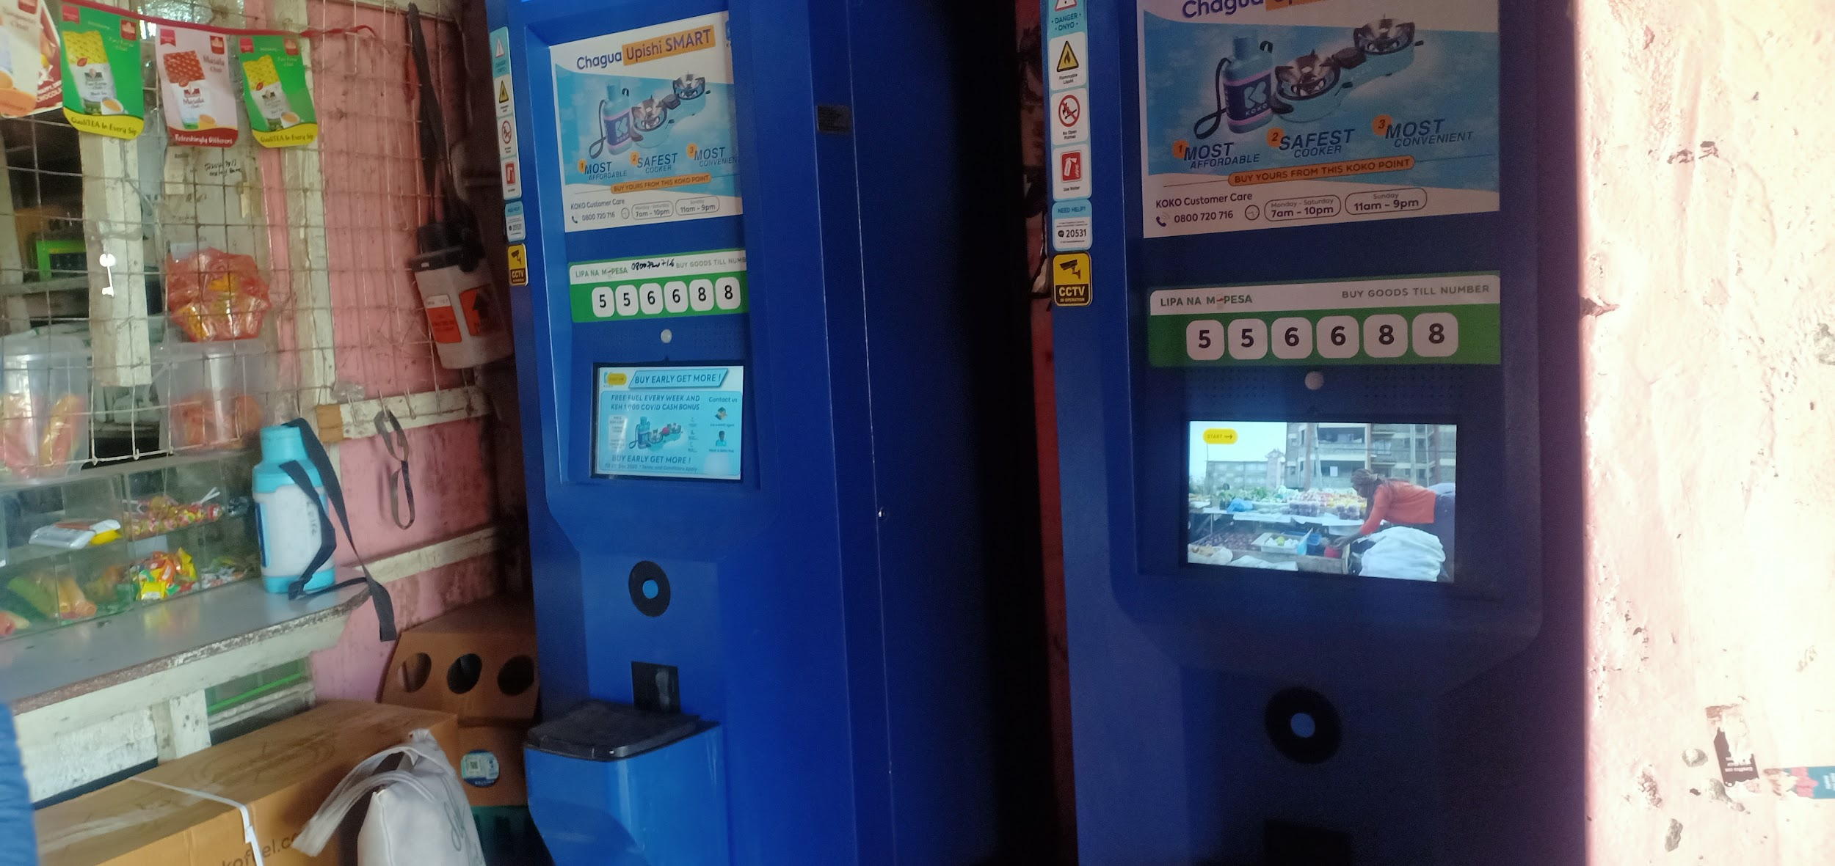
Fair Price Cereals Githurai
Location has 2 KPs installed,
Different installation experiences, 1st took about 5 months to g live, 2nd only took 2 weeks,
Size and aesthetics of it makes shop look appealing,
Most of his customers send their kids to refill on their behalf, do account top-ups at home, kids enjoy screen interaction,
KPs are installed to different heights, people think the raised KP is bigger and by default kids choose the one they can easily reach the screen, for the younger kids the agent does the refill process for them,
He has to demo to all his new clients which he is okay with,
Canister refill flow rate is slow, causes a queue in the evening when there are about 5 people at a time even with there being second KP,
Both KPs are playing different ads with no volume currently which he is okay with with, feels like the ads should visually communicate more than requiring audio to attract customers,
Between multiple KPs and a single KP with a bigger tank, he would prefer multiple KPs because it means more than one screen for customer interactions during peak hours than a single screen whose interaction has to be in turns,
Back up batteries for both KPs last for different durations, 1st KP lasts for about 30 mins, 2nd KP lasts for upto 3 hours,
Emergency button is secure, not been tampered with so far,

Slide 6
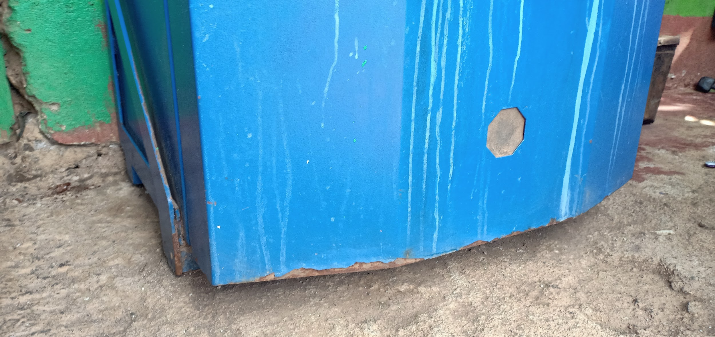
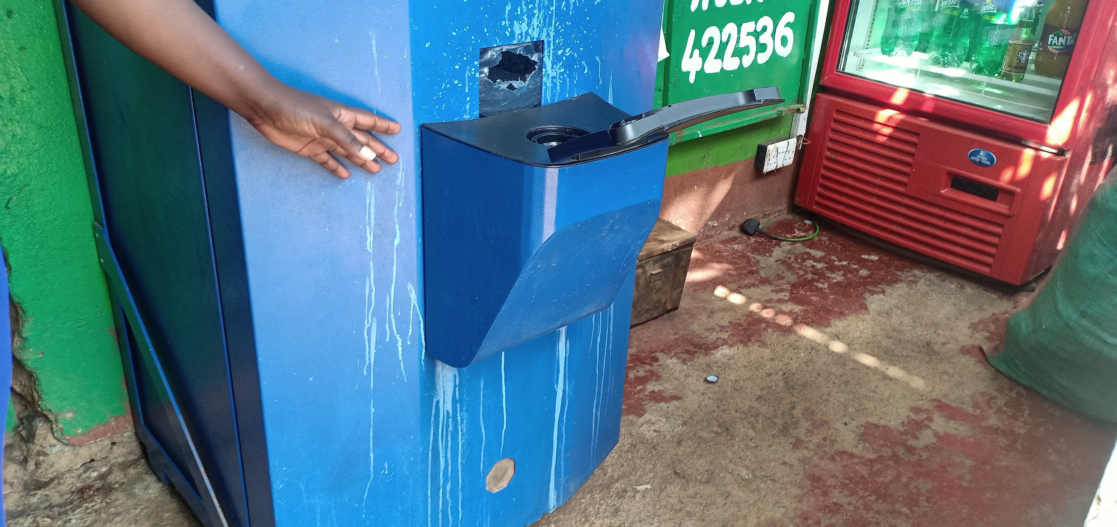
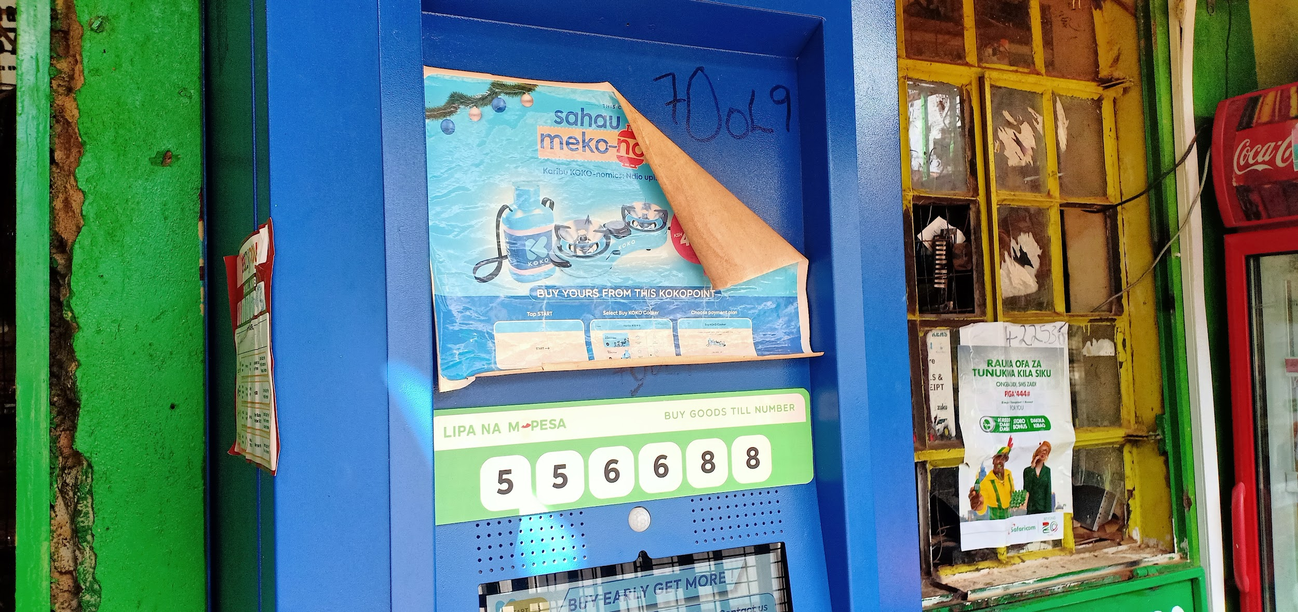
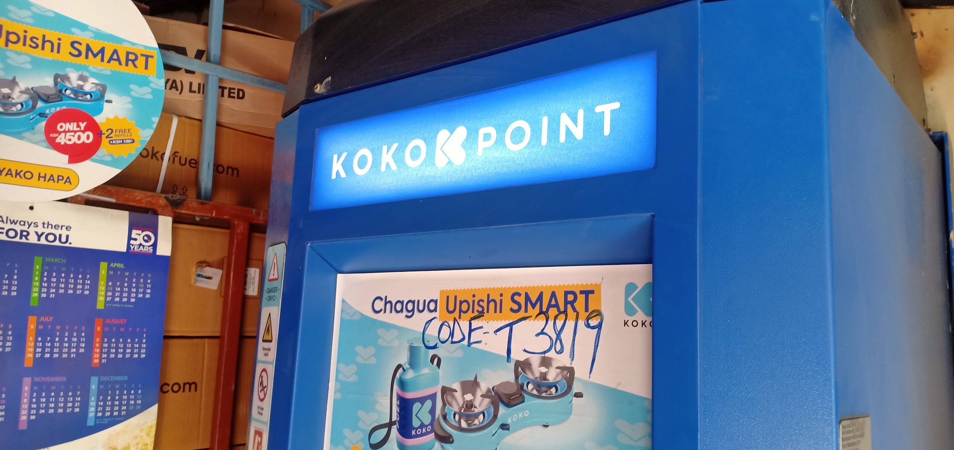
Size/Shape & Aesthetic Appeal >>Link to Images
Feedback | No. of responding agents | Effect/User Perception | Improvement Suggestions?
KP Rusting from bottom due to rain splashes | 1 | Only a matter of time before they are unappealing,
Stained KP surfaces around docking area |  | Poor paintwork/quality of paint
KP Blocking access due to its, big size | 1 | Agents think it should be installed outside,
Size and aesthetics of KP adds to shop’s appeal | 1 | Makes shop look good, attracts interest to shopping clients
Nonuniformly installed KPs (Height) for multiple KP locations | 1 | Affects height of screen, Users think they are of different sizes
Nonuniformly placed stickers |  | Generally are unappealing
Discoloured backlit ‘KOKOPOINT’ sign

Slide 7
Installation//Commissioning
Feedback | No. of responding agents | Effect/User Perception | Suggestion?
Process took months with long periods in between team visits, | 3 | Uncertainty of when new venture becomes profit making, Space reserved for KP cannot be repurposed once modification has been done on site, | Shortened periods of installation process once contract has been signed,
Inspection and modification take lots of time, |  | Understand it’s necessary but affects their other businesses inside the shop, | Include in scheduling estimated time needed so they can manage other activities around it
Though prolonged, the process was systematic, | 1 | Communication was prompt prior to visits and on schedule,
Recent KP installation and commissioning completed within short period (2 weeks), | 1 | Quick process (2 weeks) a welcome improvement,
Would prefer installation outside shop, | 2 | KP markets itself better if installed outside, KOKO sign isn’t clearly understood yet by non-KOKO customers,

Slide 8
Fuel Refilling
Feedback | No. of responding agents | Effect/User Perception | Suggestion
KP refills are not inconveniencing to other business activities, | 3 | Appreciate how simplified process is once micro-tanker is on site (Quick and precise),
KP refills compete with other business stock deliveries, | 1 | Activity disruption for locations with limited parking spaces, | Prior planning and comms,
Refill visits are not communicated beforehand for clearing of parking space or for agent to plan shop opening time (internal refill box), | 2 | Guessing game of date and time for refills,
KP tanks not filled to capacity during refills, | 1 | Stock outs and KP refills become frequent,
High traffic locations run out of fuel quickly, | 2 | Customers leave their cans with agent to refill on behalf when fuel is available, Customers go to other KP locations causing agents to lose out on commissions or permanently loose refilling customers,

Slide 9
Fuel Storage & Inventory Monitoring
Feedback | No. of responding agents | Effect/User Perception | Improvement Suggestion
KP tank size needs to be increased, | 1 | Agents with increasing number of customers with limited space
Great there is no contact with fuel ‘open access’, |  | A sense of safety from fire or other hazards
Increase number of KPs in shop, | 3 | Agents with increasing number of customers with plenty of room,
Current KP tank capacity is okay for current number of customers, | 1

Slide 10
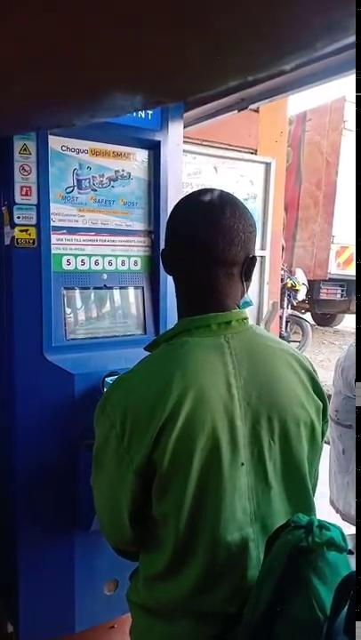
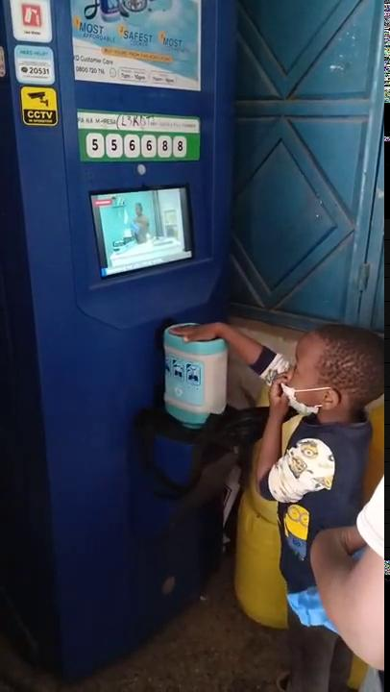
Fuel Dispensing
Feedback | No. of responding agents | Effect/User Perception | Improvement Suggestion?
Dispense rate too low and customers end up queueing during peak hours, | 3 | Agent/Customers think it’s because can is refilled upside down,
Customer unable to select purchase amount (greyed out)after a canister full error, | 1 | Need to have an alternative at home incase they can’t access fuel
Most customers send kids to refill canisters, | 1 | It is fun for kids to use, Incase there is a queue, kids can wait,
Canister difficult to dock and undock for some kids and older customers, | 1 | Agent has to always assist in this process that’s supposed to be self-service, affects their other activities,
Video 1: Agent staff assisting with can refill
Video 2: Kid refilling assited by an adult,

Slide 11
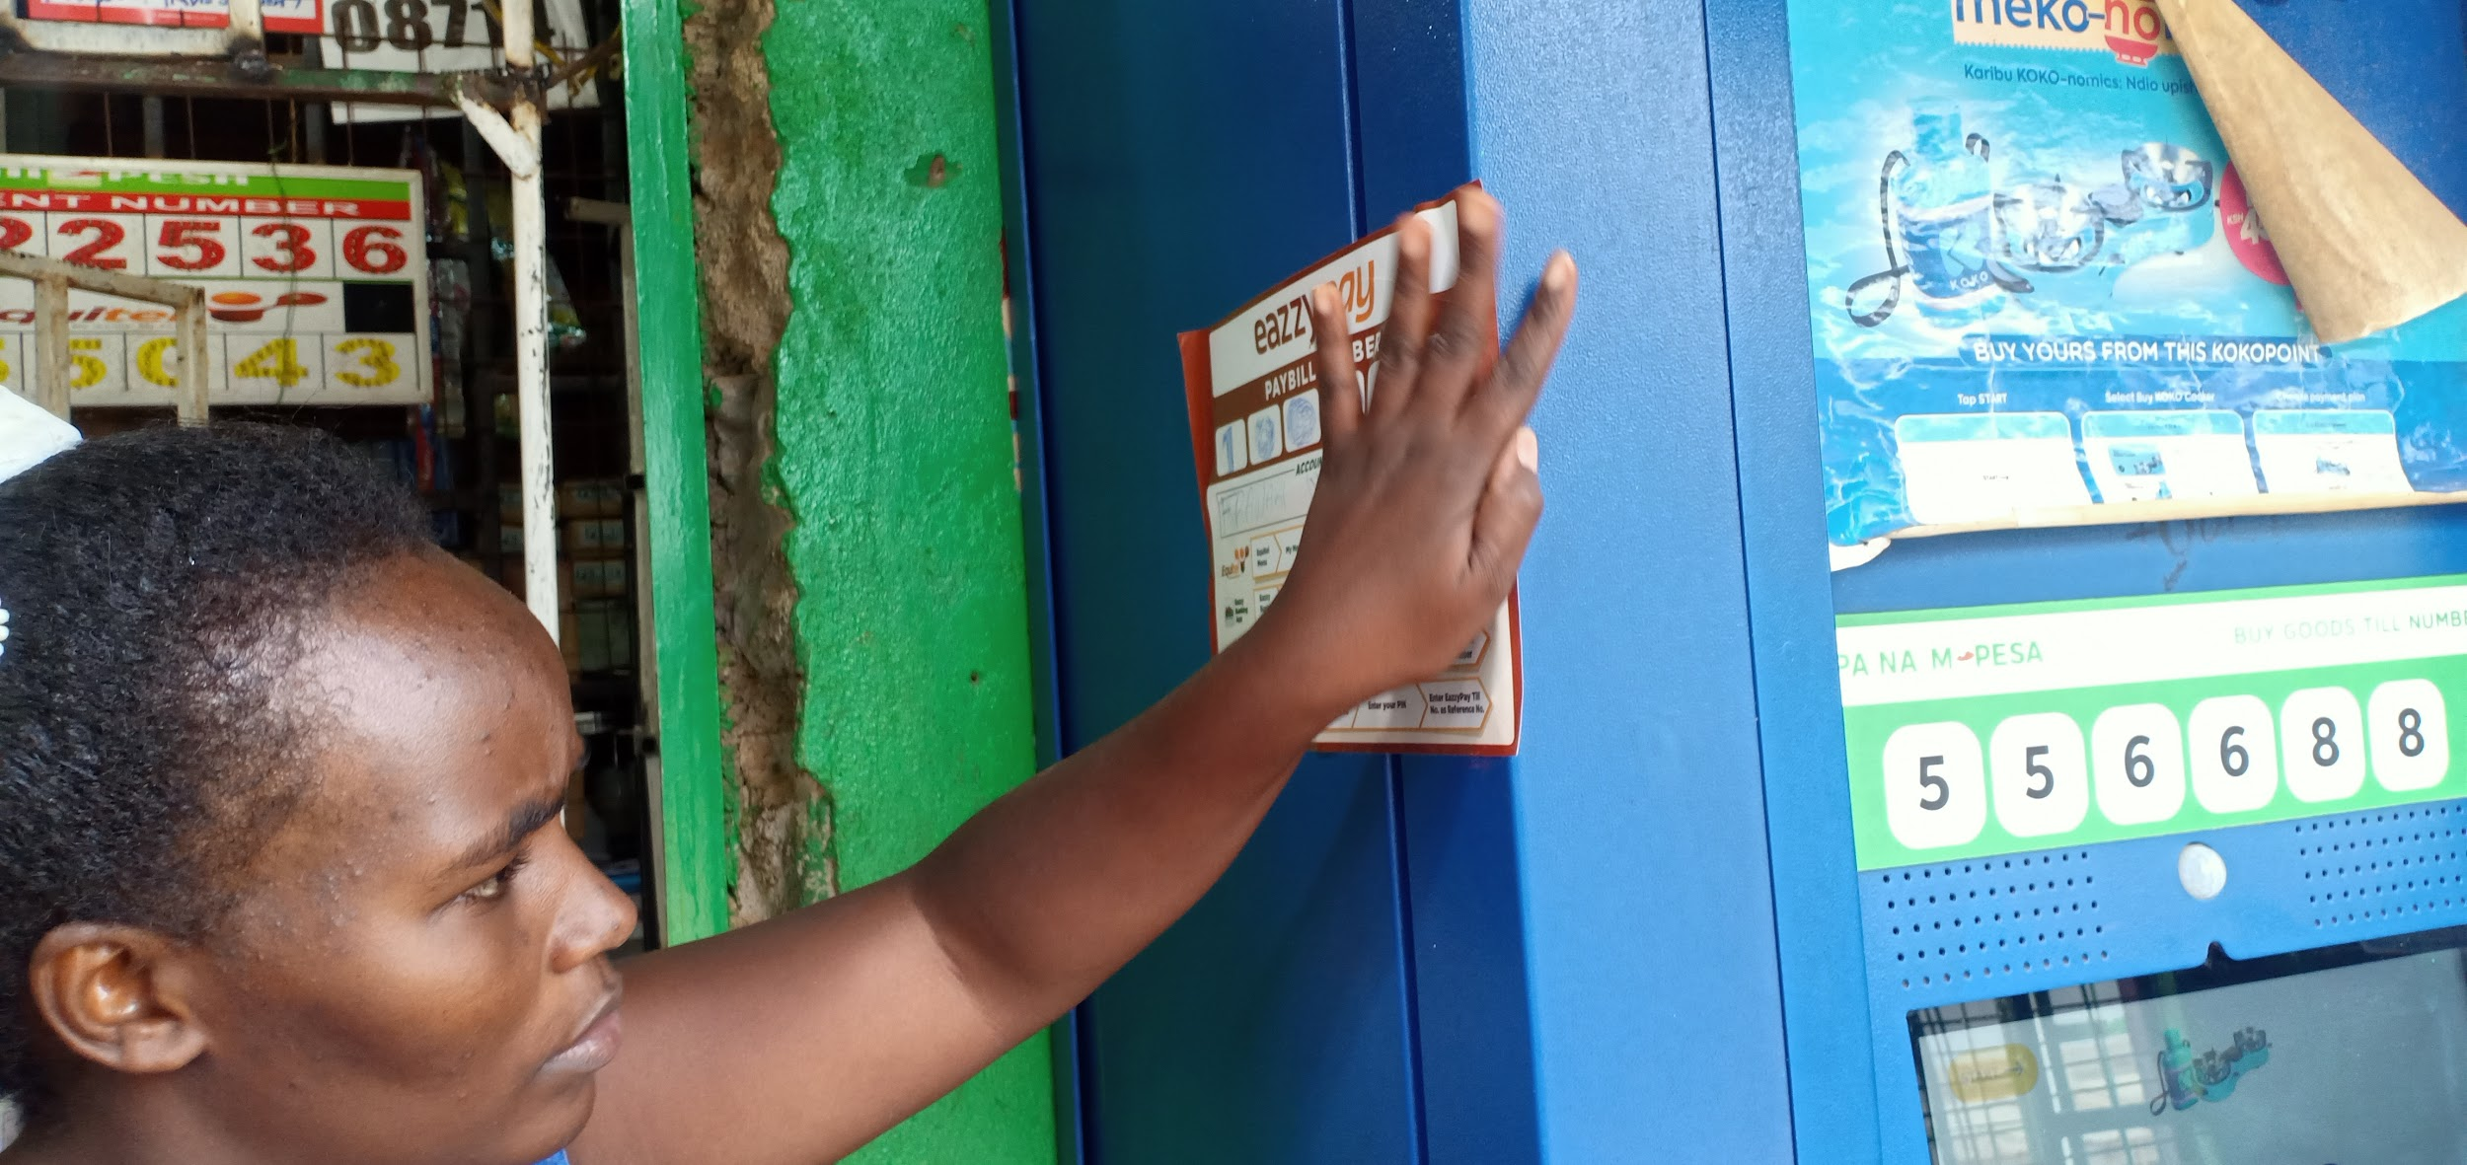
Fuel Safety Features & Hazard Avoidance
Feedback | No. of responding agents | EFFECT/USER PERCEPTION
Emergency switch blocked with advert poster to prevent random customers switching the KP off | 1 | Button manipulation causes KP to go off inconveniencing refilling customers, has to call customer care to restart
Emergency button secure - not tampered with so far | 1 | Depending with KP placement inside store, cannot be accessed,
Fuel spilling around docking area during refills
Fire extinguisher availability/inspection? | 1 | Understanding that ethanol fires can be put out with water, Is fire extinguisher necessary? Does KOKO check post installation?
Image: Agent blocked emergency switch with an ‘eazzy pay’ poster to prevent accidental/intentional switching by customers

Slide 12
Power Supply & Backup
Feedback | No. of responding agents | Effect/User Perception | Improvement Suggestions
Multiple KPs in single location - Old KP (1 year + in shop) lasts only 30 minutes on battery while recently added KP lasts up to 3 hours | 1 | The longer a KP is operational, the more unreliable back-up power gets,
Backup capacity sufficient during outages | 1 | Minimum periods of outages
Outages not frequent but has backup generator | 1

Slide 13
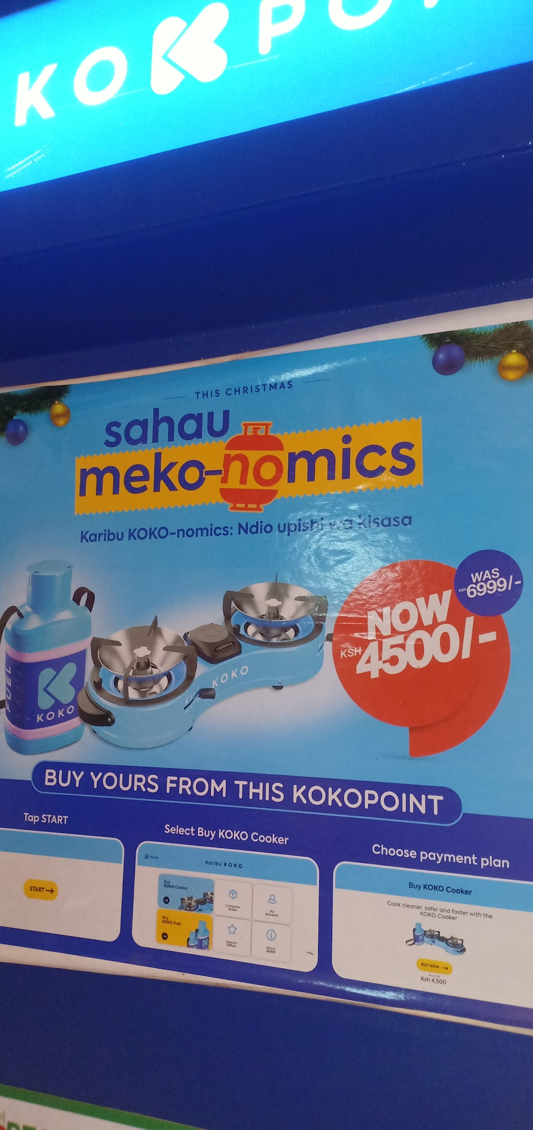
Screen & User Interface
Feedback | No. of responding agents | EFFECT/USER PERCEPTION
Frequent KP screen freezes (at least once a week) | 2 | Unreliable KP App, having to call Customer care takes long,
Screen not clear due to exposure to direct sunlight | 1 | Running ads on idle screen are not visible
Kids enjoy screen interaction | 2 | Main reason parents send kids, Them playing with it has no impact
Kids (who are the majority users) prefer lower set screen | 1 | Agent has to assist during refill which means sharing secret ‘PIN’
Switch to restart KP screen when it freezes,

Slide 14
Discussion Notes
Link to images

Slide 15
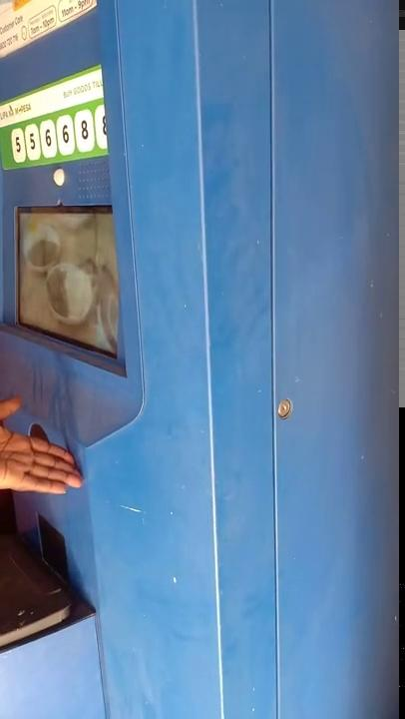
Unit Internal Access & Maintenance
Feedback | No. of responding agents | Effect/User Perception | Improvement Suggestion
Pleased that KP can be taken out of service remotely in case of an issue | 1 | Increased sense of safety
Happy to have learnt of the usefulness of the soft reset switch when a screen freezes | 2 | As an alternative to calling customer care incase of such issues,
Varying levels of ads volume, often manipulated by KOKO technicians, not sure what criteria is used to determine levels, What happens to locations with more than one KP? Same Ads? Volume levels? | 2 | Would like to be in control of advert volume levels to adjust at different time-periods of the day depending on traffic and need,
KP main door lock strike comes loose | 1 | Sense of KP not being secure from external manipulation when they are not seeing,
Video 1: Agent staff assisting with can refill
Image: Different running ads on KPs - Currently muted due to conflicting audio

Slide 16

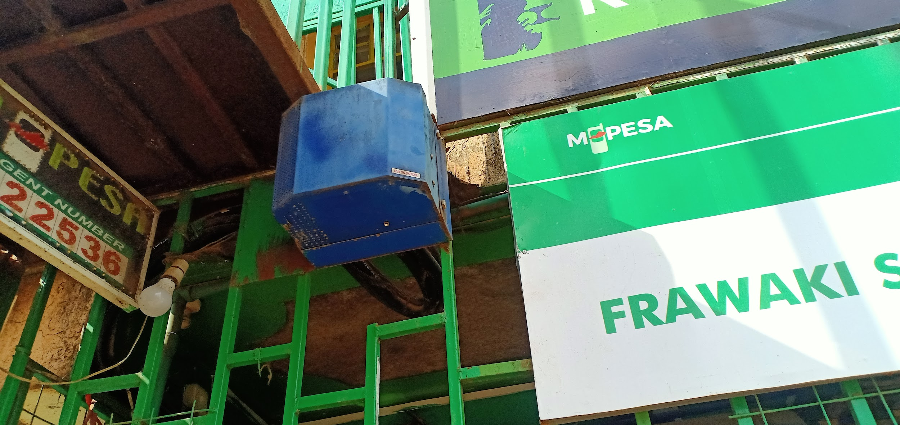
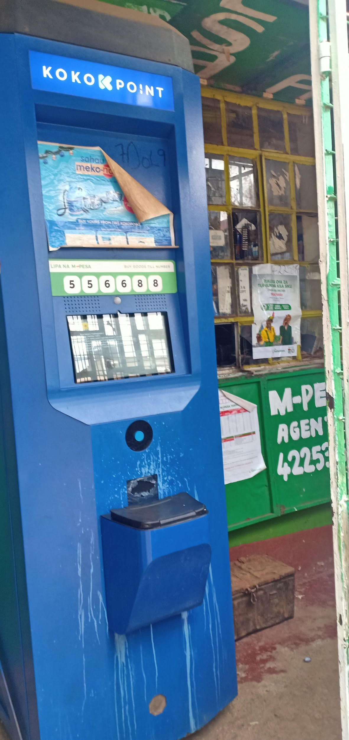
Frawaki Supermarket
Installation process was slow, took 2 months + from inspection to KP installation and wasn’t still turned on immediately,
She has trouble with random customers pressing the emergency button accidentally which turns KP off and then she has to call customer care for a restart , has had to block it with an ‘eazzy pay’ poster,
KP has began to rust from the bottom, gets rained ,
Area around dock is discoloured possibly due to ethanol spills
Screen isn’t clear as it is in the way of direct sunlight,
Kids around the area play with the KP screen but has no problem when she can’t control them as their actions haven’t impacted anything so far
Feels like the size of KP is big and sort of blocks the counter from where she serves the customers,
KP tank capacity is fine with her for now as her customer base isn’t big and hasn’t suffered periods of stock-outs,

Slide 17
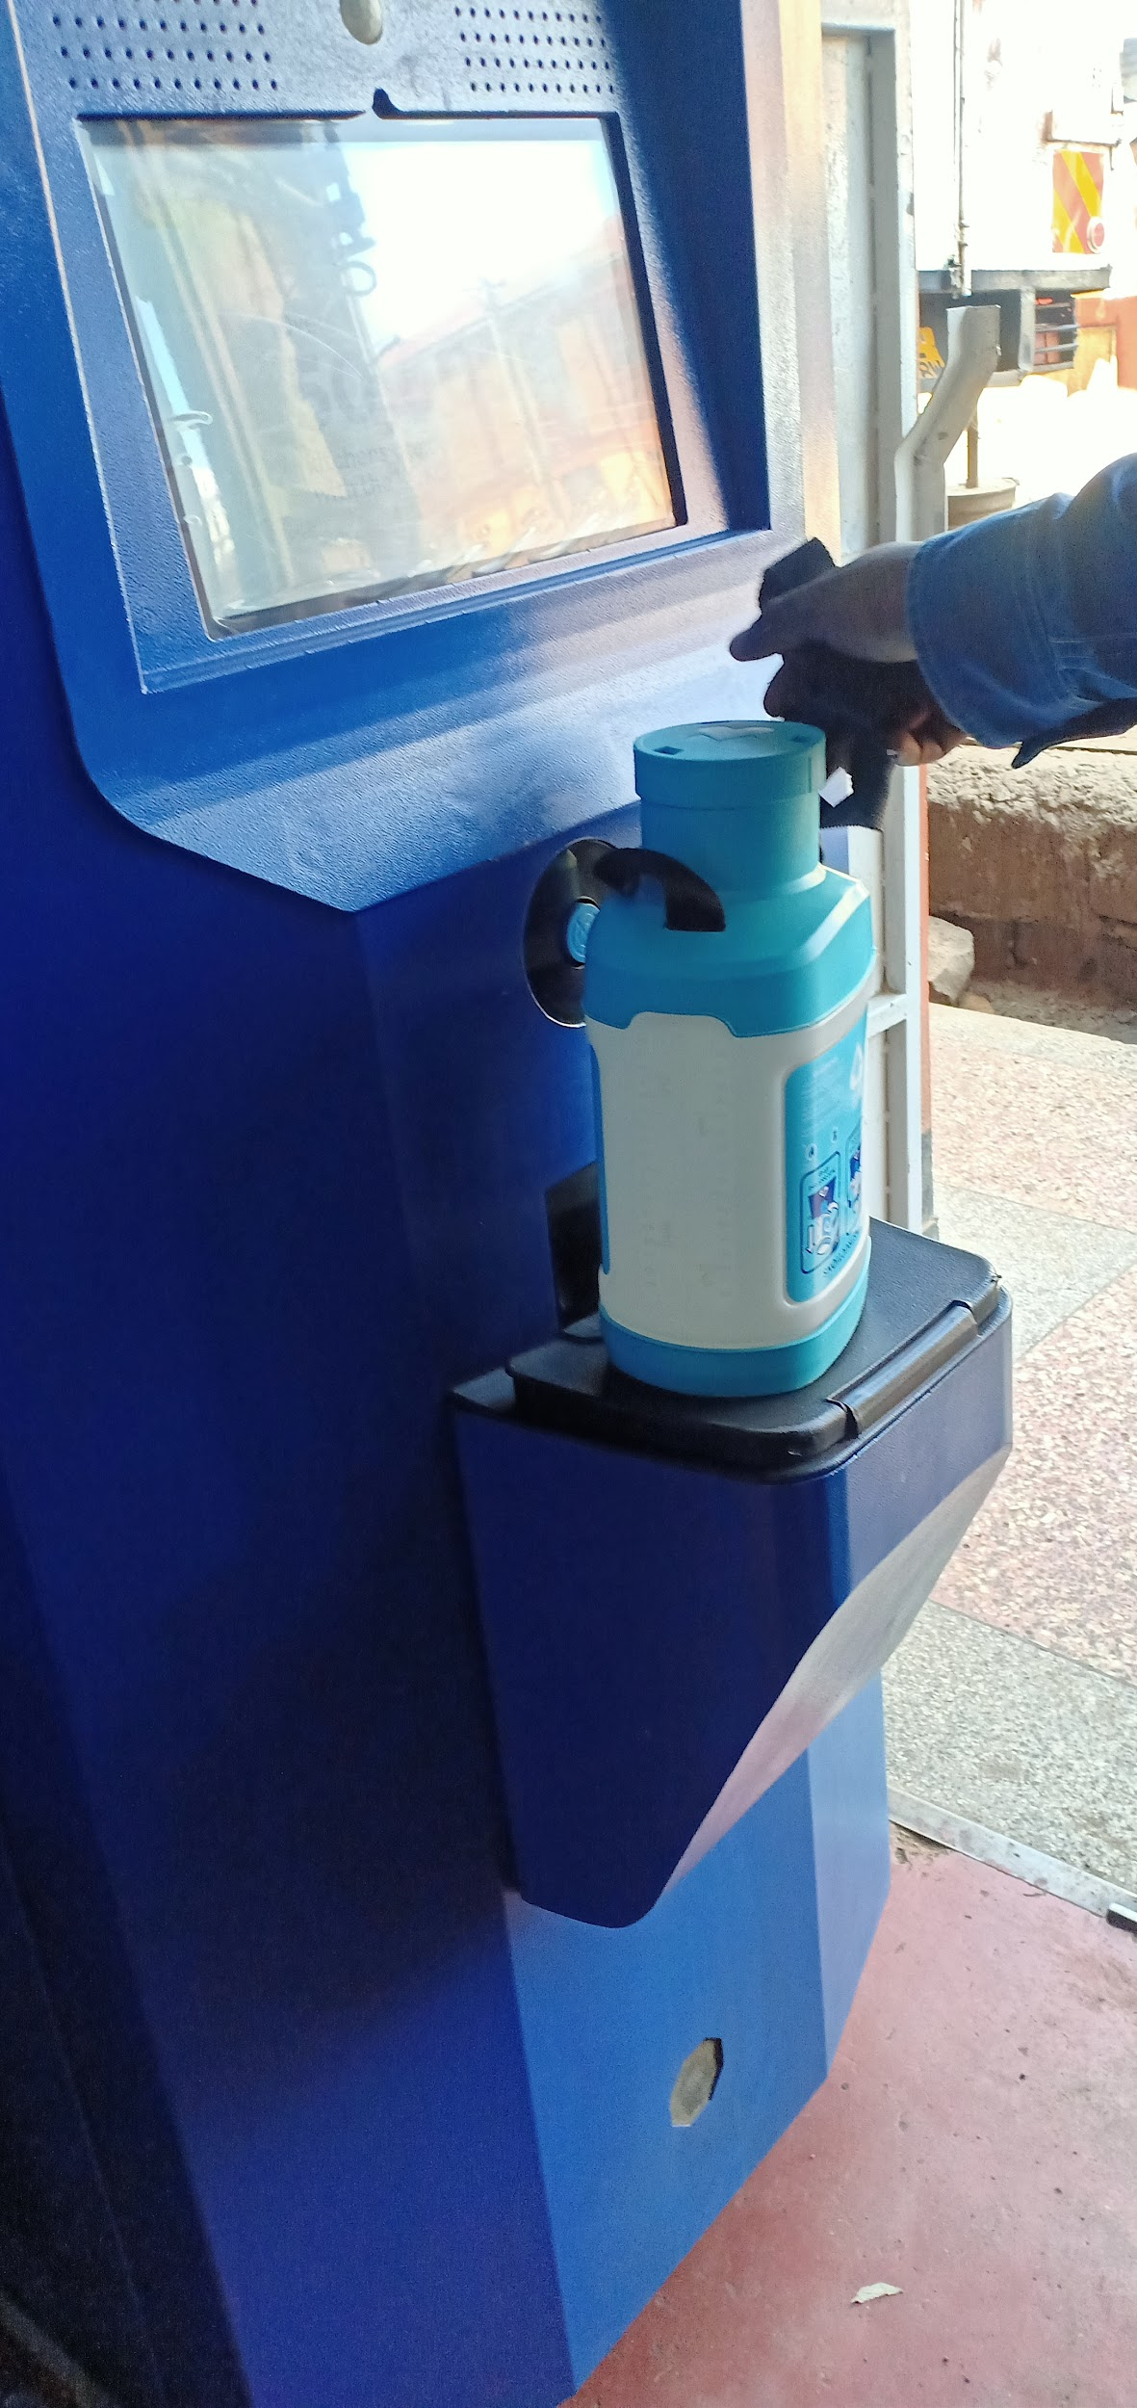
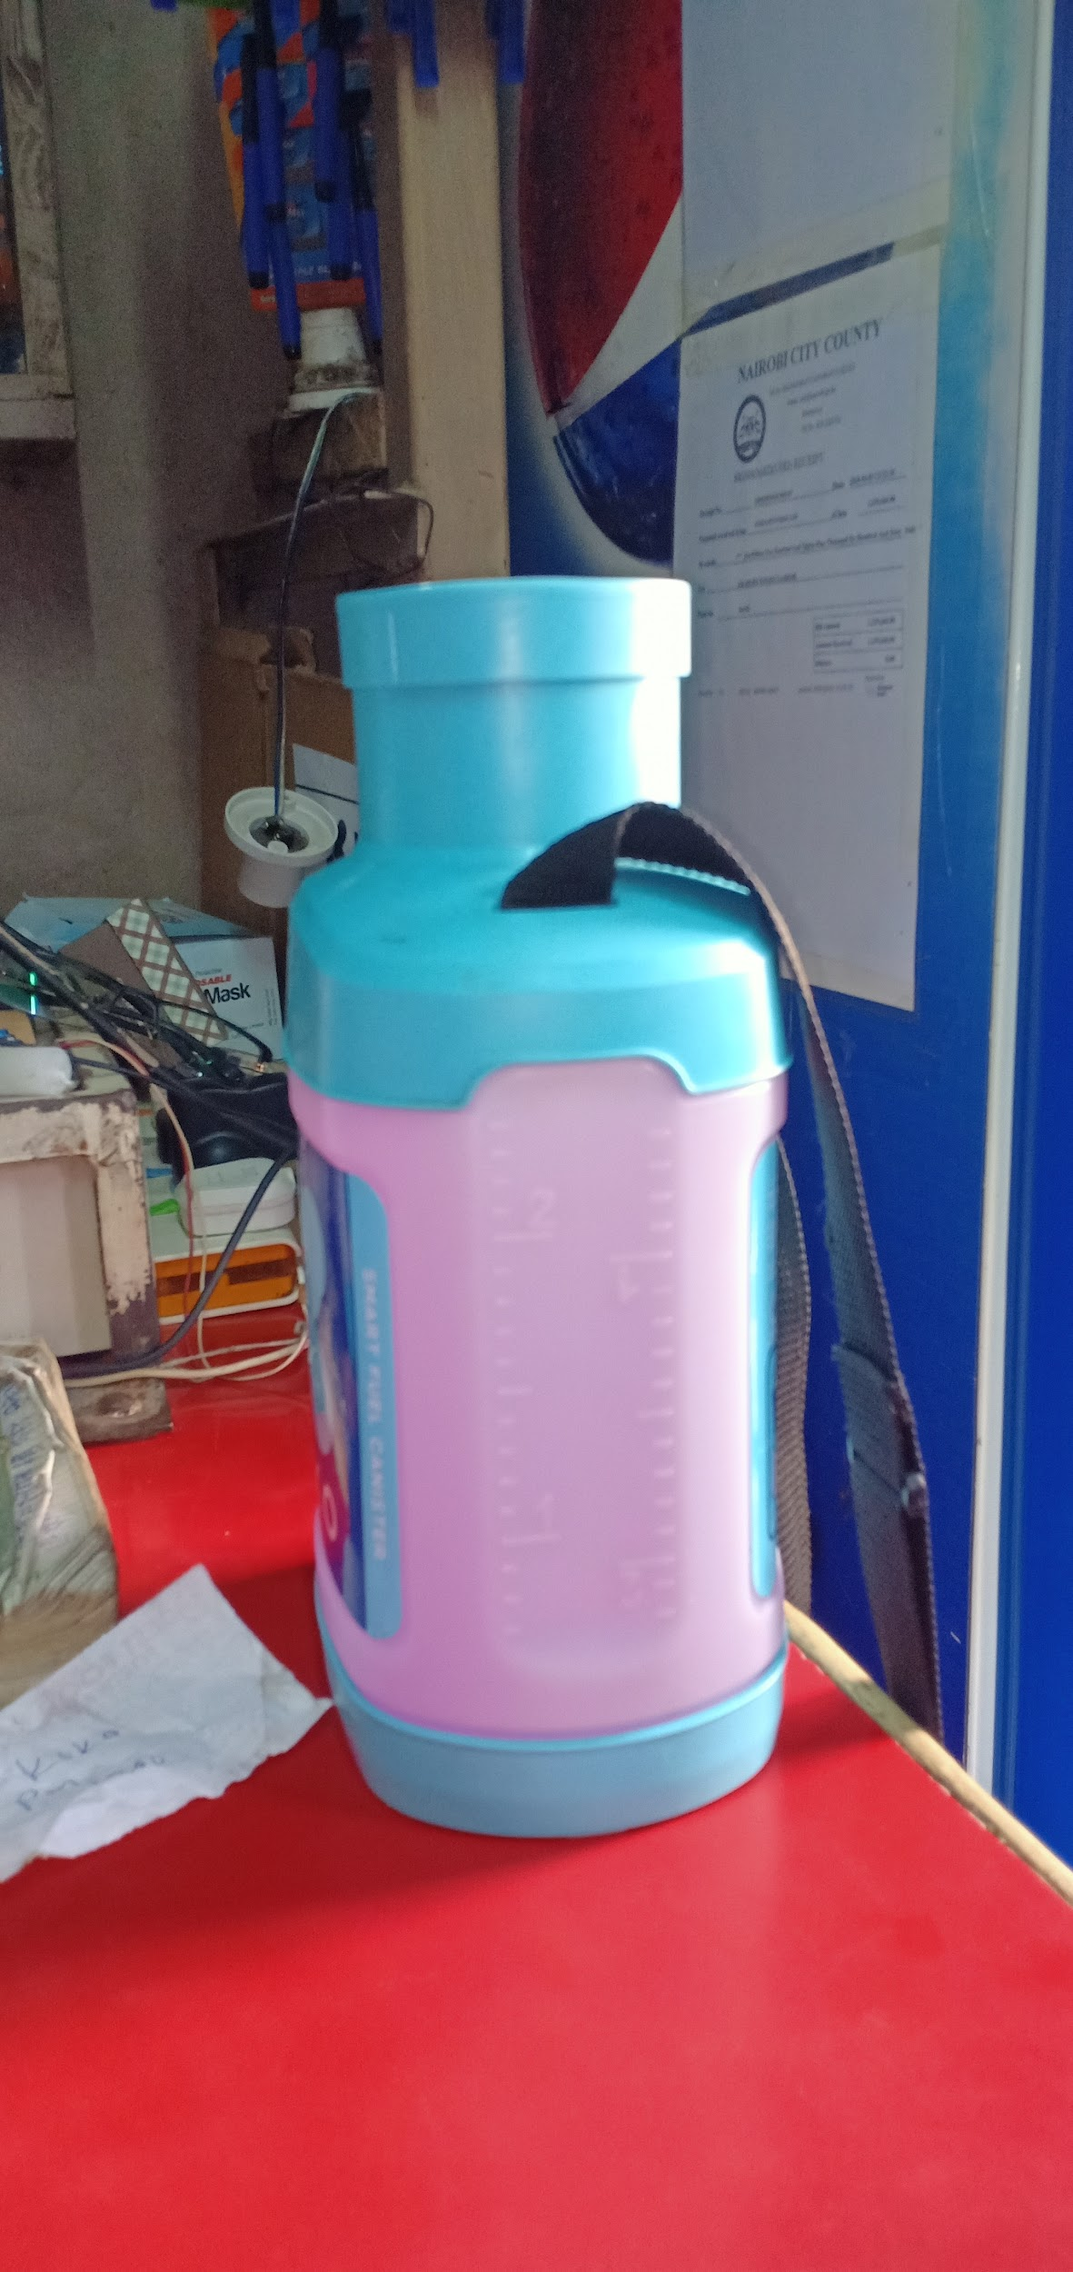
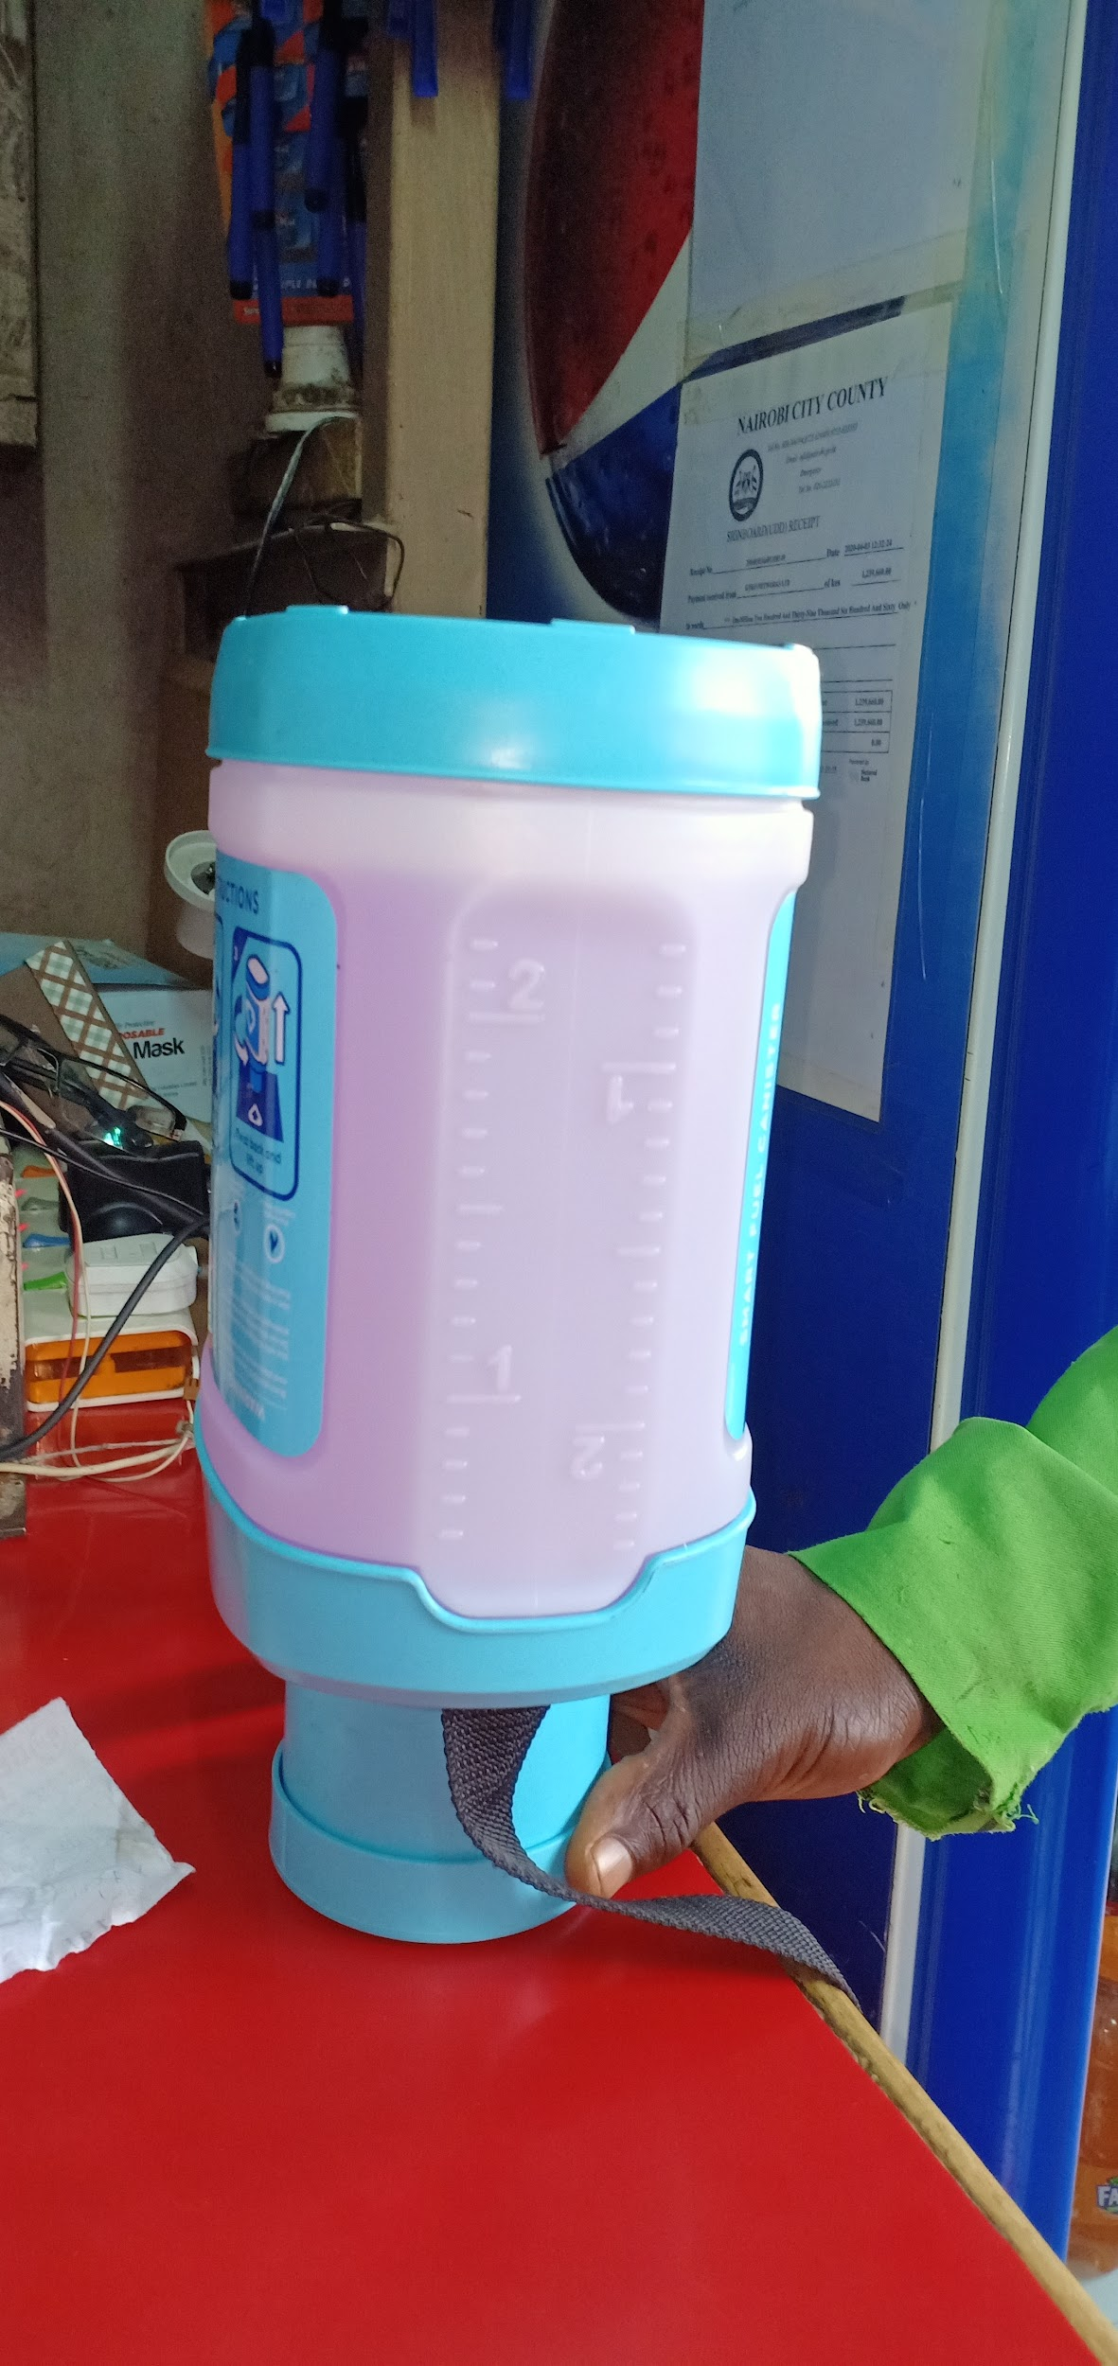
Stepa Supermarket
Installation process was long but was systematic, inspection >> modification >>installation,
Likes its size but feels it should be outside for people to see (outside branding isn’t enough for people to know that there is a KP), gave an example of coca cola insisting on their fridges being outside,
A question he gets from customers a lot is why the canister is refilled upside down,
Has had quite a lot of issue with “canister full” during refills,
Feels the need to assist most of customers who come to refill,
Would be better to simplify the process of changing kit ownership for clients who are gifted or bought on behalf of spouse/relative,
KP tank capacity is ok but feels like KP tank isn’t refilled fully during refills and has to be done on a weekly basis,
Canister refill is slow,
Battery capacity has been sufficient in the event of outages, except a time when there was a 3-day power outage

Slide 18
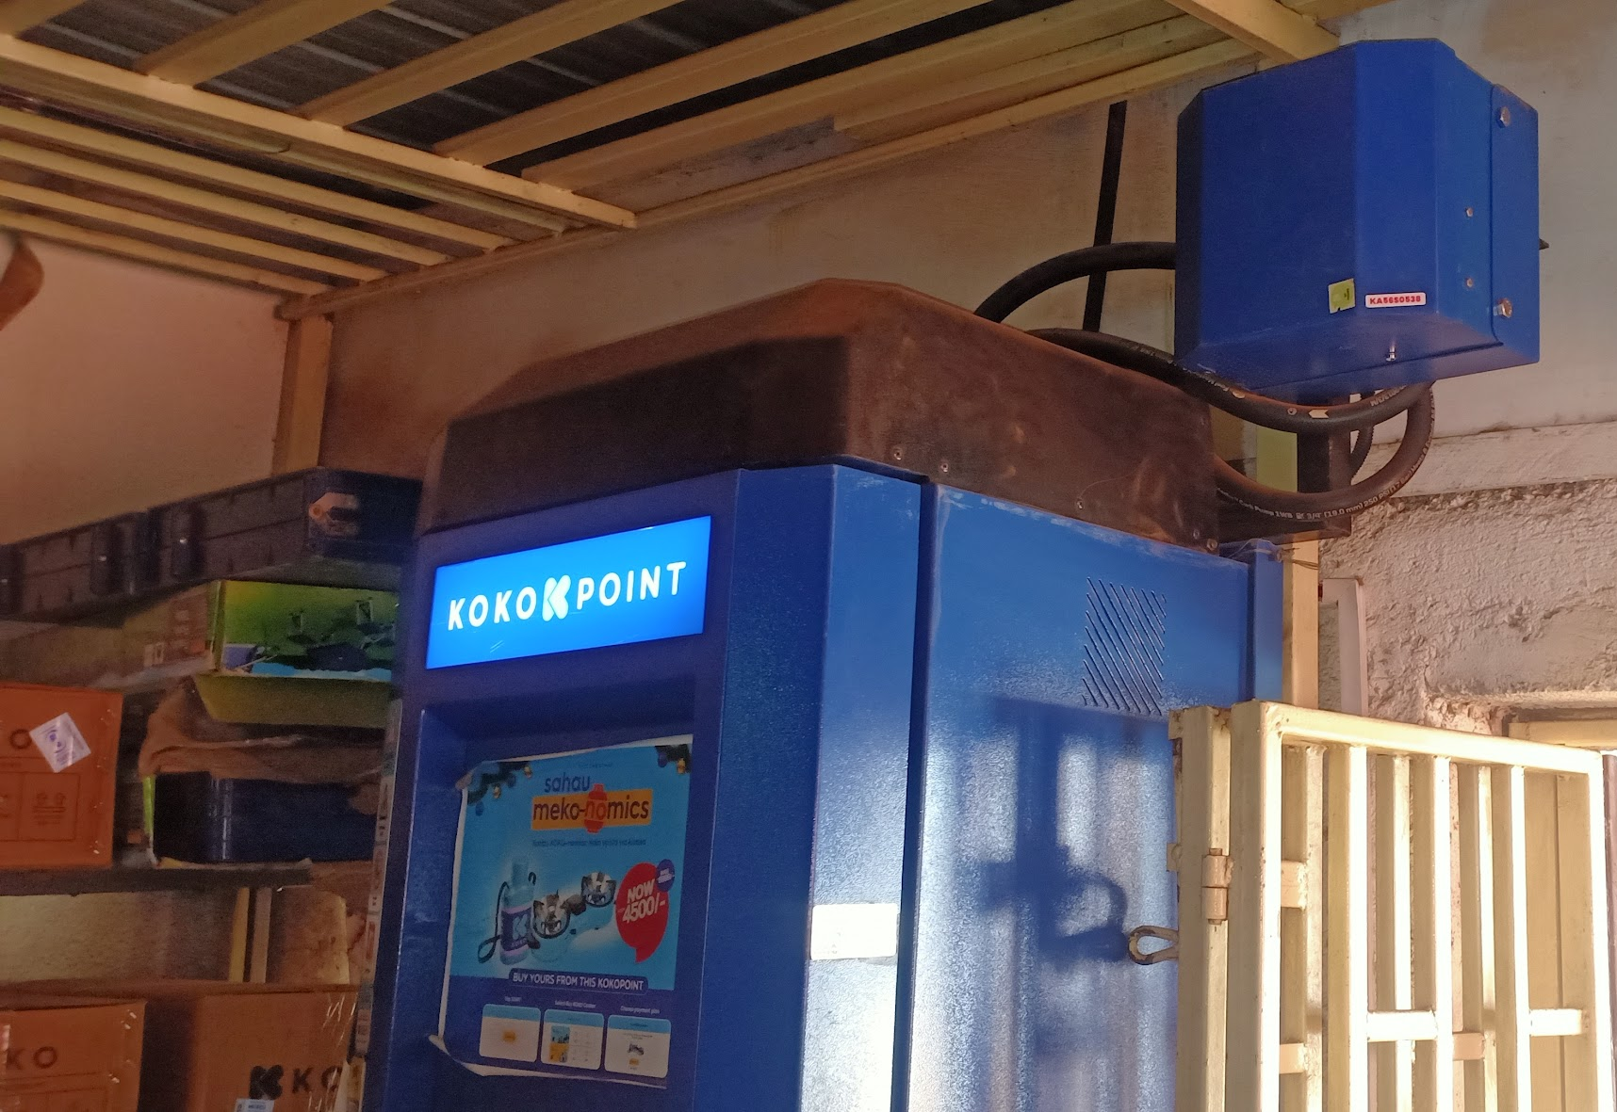
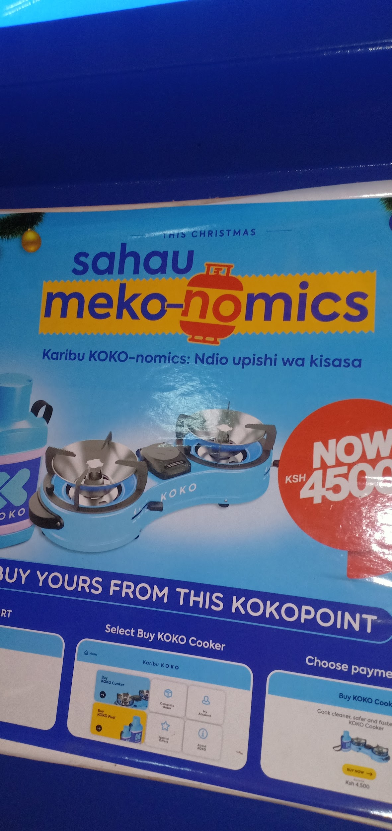
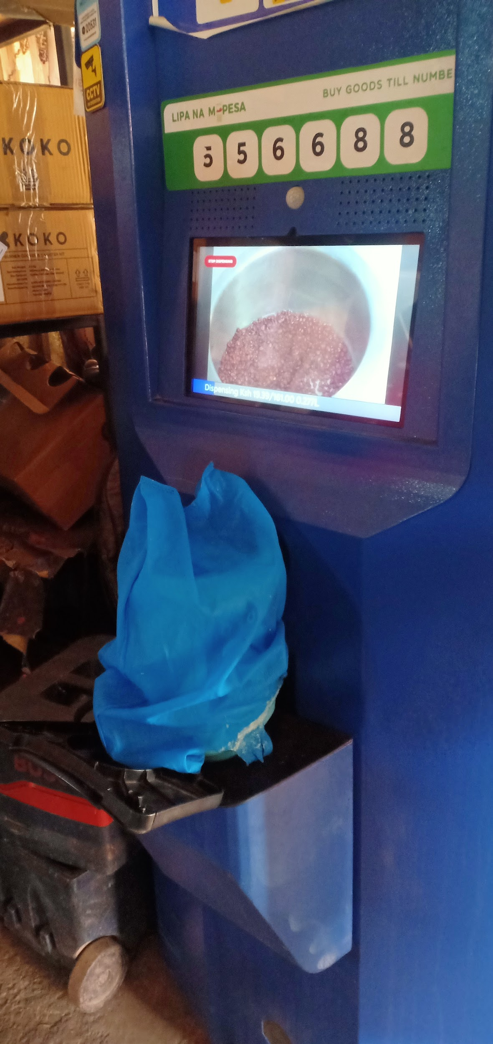
G-Unit Store
KP once leaked ethanol and felt KOKO’s response was quick,
Appreciates KP can be remotely taken out of service in case of emergencies,
KP screen freezes at least every week & doesn’t work until restarted, before she would call the office to remotely restart but she now does it herself after being informed about the soft reset switch,
Refill box is located inside shop she feels obligated to open her shop early to facilitate this even though her business isn’t an essential goods trade, (would like to be notified about such visits)
Refill doesn’t affect her activities instead she feels the micro-tanker attracts new customers,
KP has its volume muted, would love to be in control of the sound level,
Would have preferred to have the KP outside for customer visibility even if it means her building a cage for it, feels like the branding sign doesn’t communicate clearly what KOKO is,
Has to help kids dock and undock after canister refills,

Slide 19
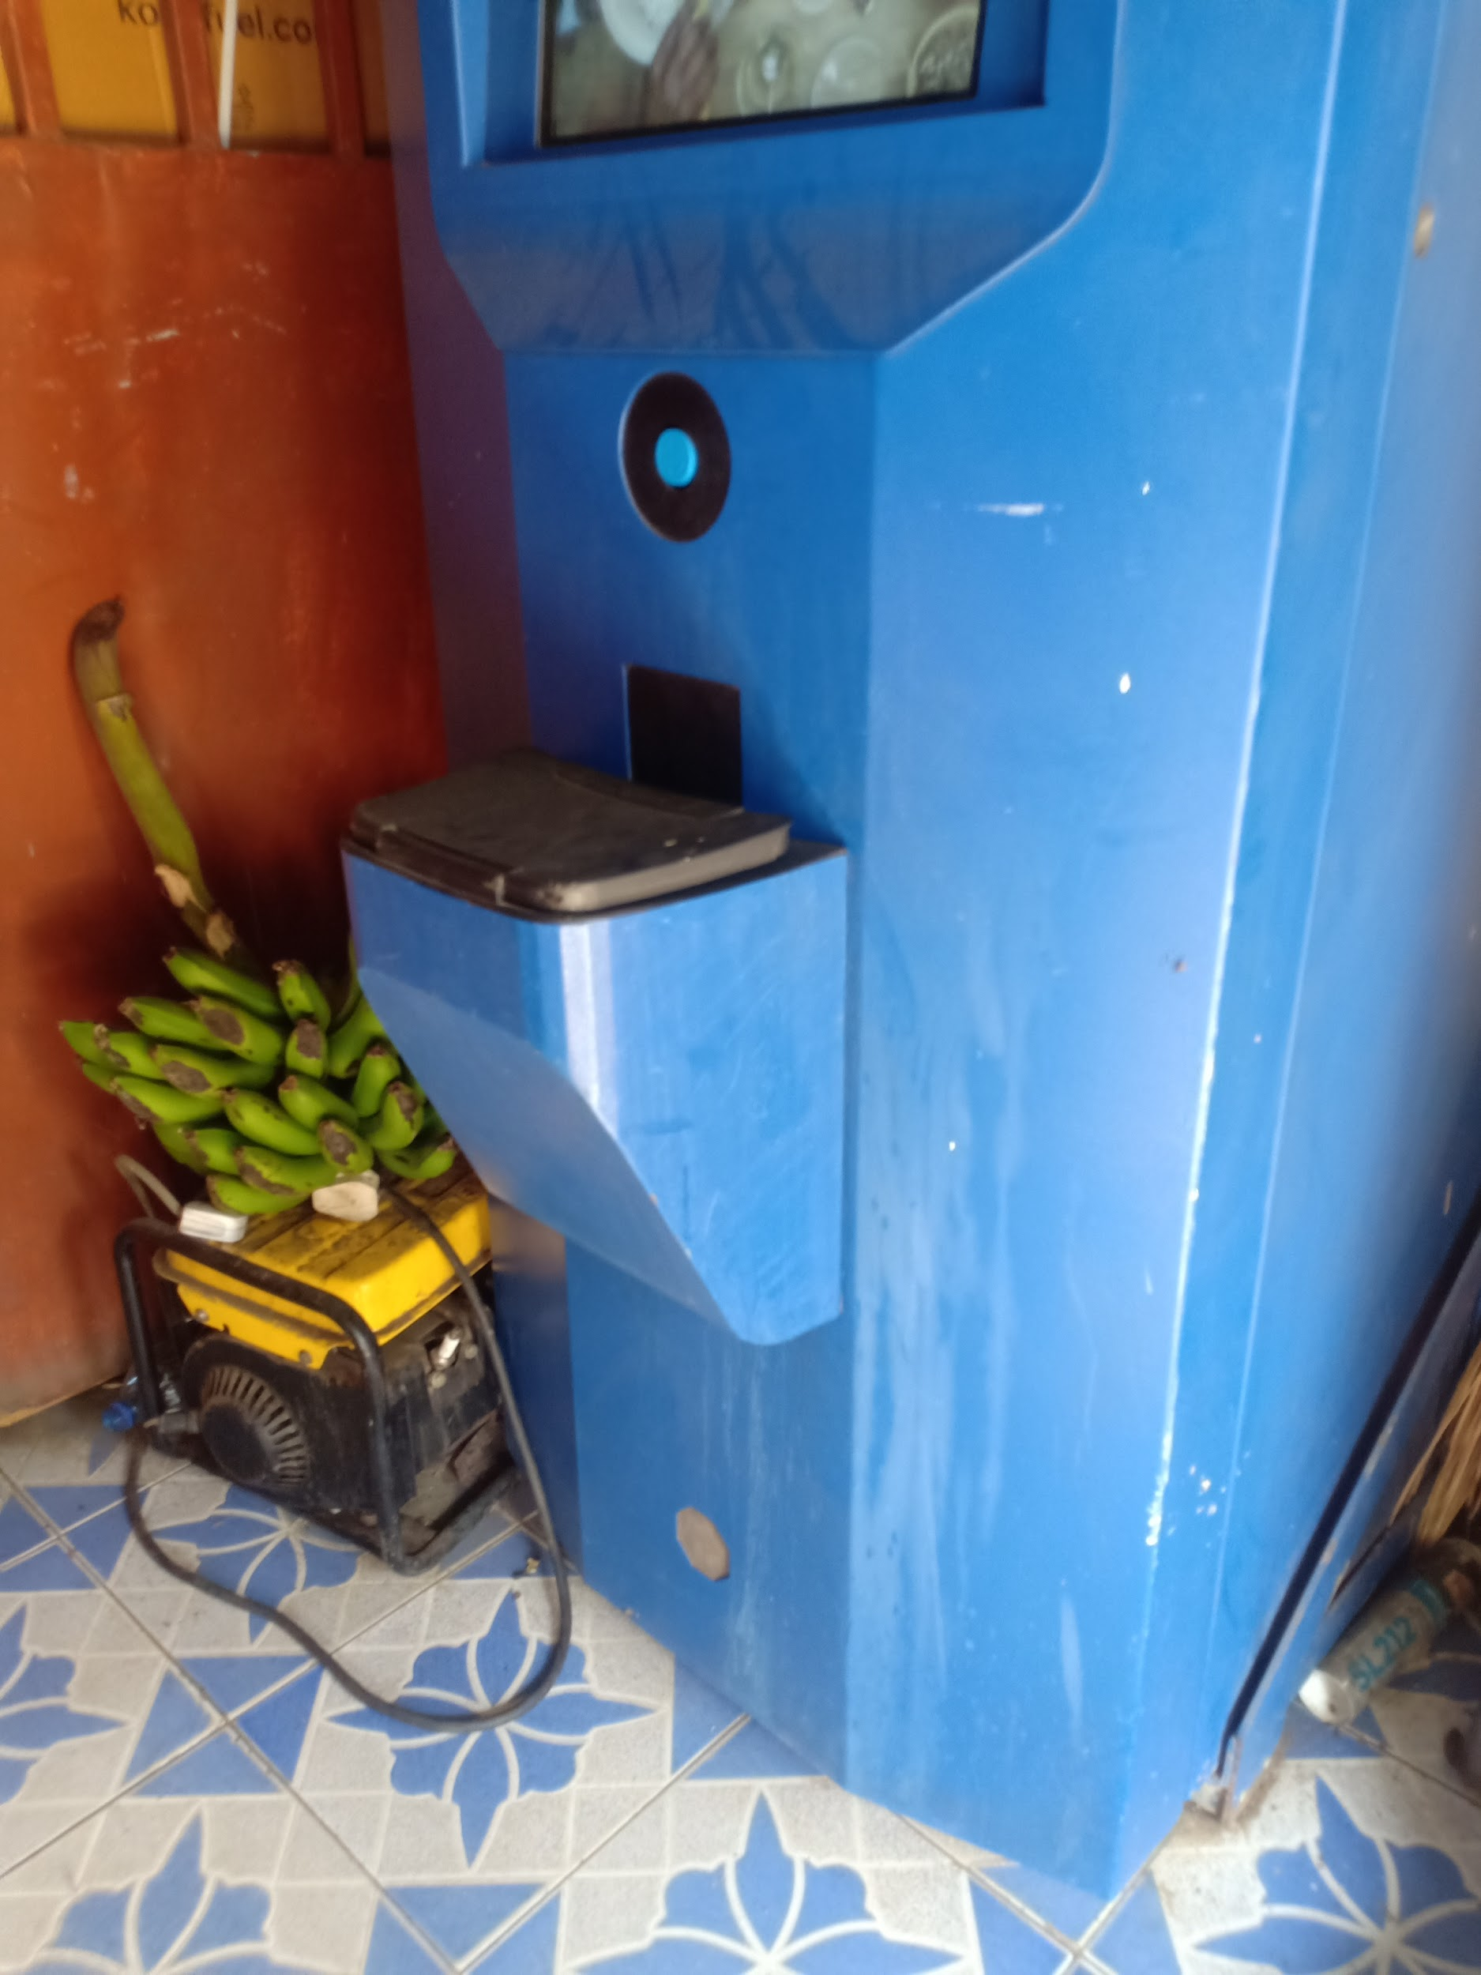
Kariobangi Memory Ent.
Installation process took very long, KP installed 3 months after modifications and went live 2 months later. Couldn’t repurpose the space in the 5 months they waited for KP to be operational,(Suggestion 2 weeks max should be sufficient)
KP screen often freezes or doesn’t recognize canisters, has learnt how to restart it instead of calling customer care to restart which takes time,
Canister refill flow rate is slow, inconveniences customers in the evening especially now with the ‘curfew rush’,
Customers don’t leave their canisters with her, treat their PIN very secretly just like an MPESA PIN,
KP interaction is fun for kids and find it very easy. She however has to help older customers especially with docking and undocking, they don’t understand it is the same as cooker refilling,
Current ads are relevant but would love a bigger screen for this purpose , also love to be in control of volume levels,
KP refills is done 2-3 times a week and for this reason would love a bigger tank,
Wouldn’t mind a second KP since she has a separate room
Refills are also not scheduled or communicated prior, mostly coincides with her stock deliveries yet she has limited parking space outside,
Does not have frequent outages but has a backup generator even when they occurred.

